Slide 1

Winged Deer Park Economic Impact Study
Kent Roller, Toby Adebiyi, Adade Yeboah
Kevin Willis, Richard Ojo, Katelyn Williams

Slide 2

Outline
Project Goals
Initial Data Sets and Analysis
Survey
Multiplier Effect and Impact Estimation
Input Output Model
Moving Forward

Slide 3
Project Goals
Collect all possible data from local government sources
Distribute created survey to obtain additional data
Use
Secondary Studies
for data not found
in previous steps.
Create estimates for each sport based on preceding data
Apply multipliers using RIMS II I/O model table for the region

Slide 4
Initial Data Analysis
Some initial calculations made with data received and assumption of
$206/day spending. Future calculations may differ

Slide 5
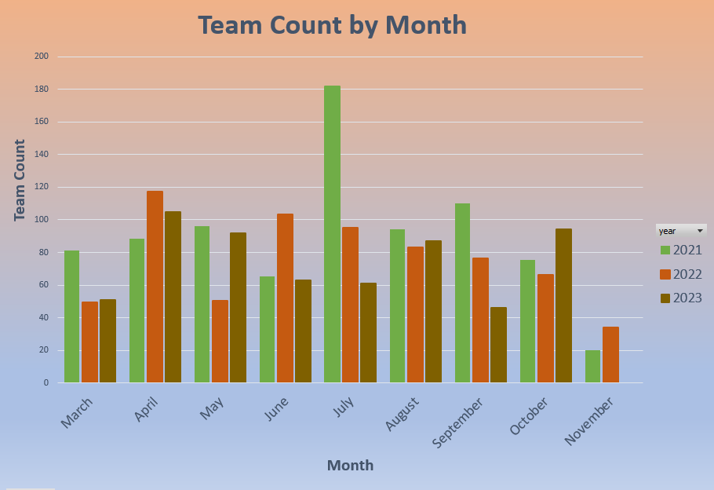
Number of Teams by Month
Number of teams playing on the fields compared by month and year

Slide 6
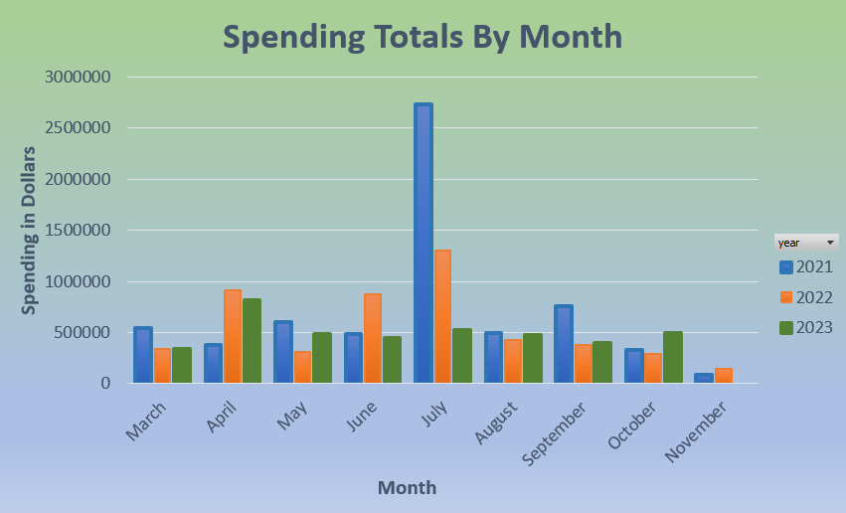
Visitor Spending Totals by Month
Visitor Spending in the region broken down by month and year for comparison

Slide 7
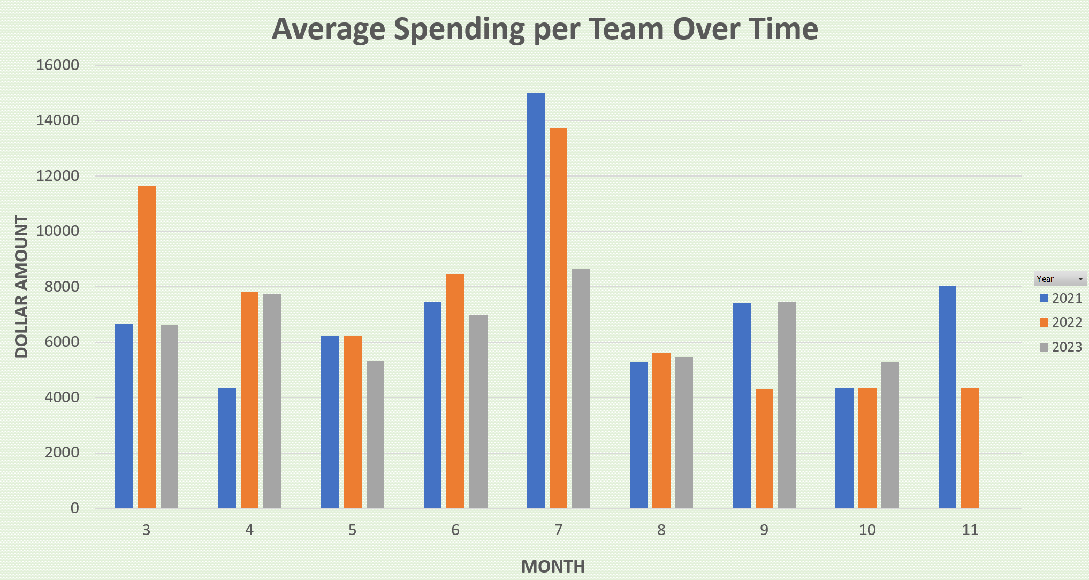
Average Spending by Team
Here we have a breakdown of the average spending per team over time so we
can compare spending by team between years

Slide 8
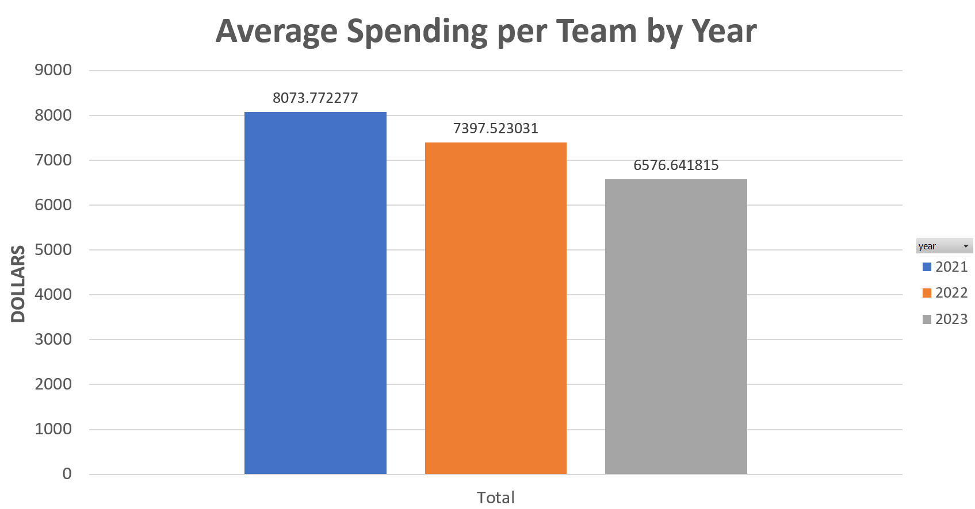
Average Spending per Team by Year
Here we see what each team spent on average compared by year. Unfortunately,
this number appears to be decreasing.

Slide 9
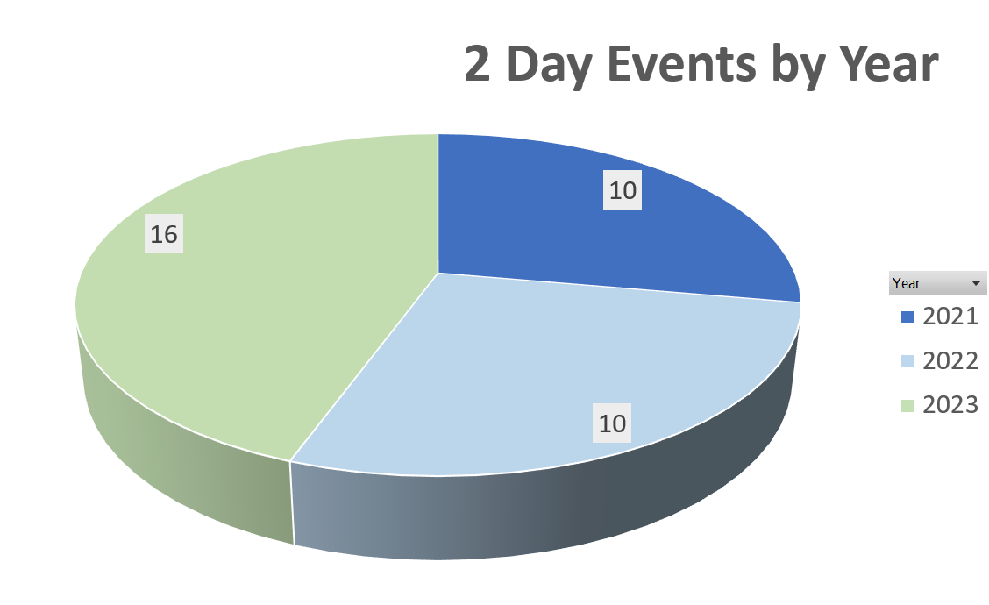
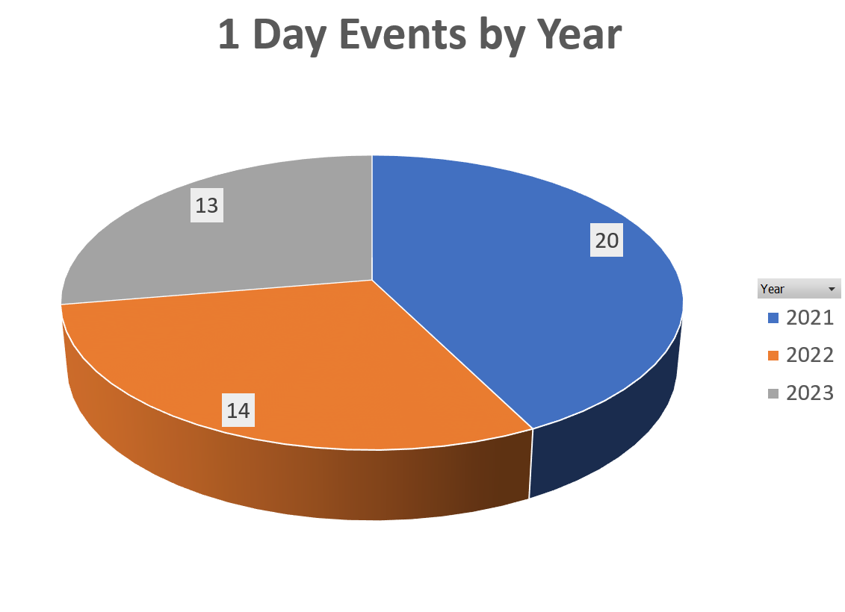
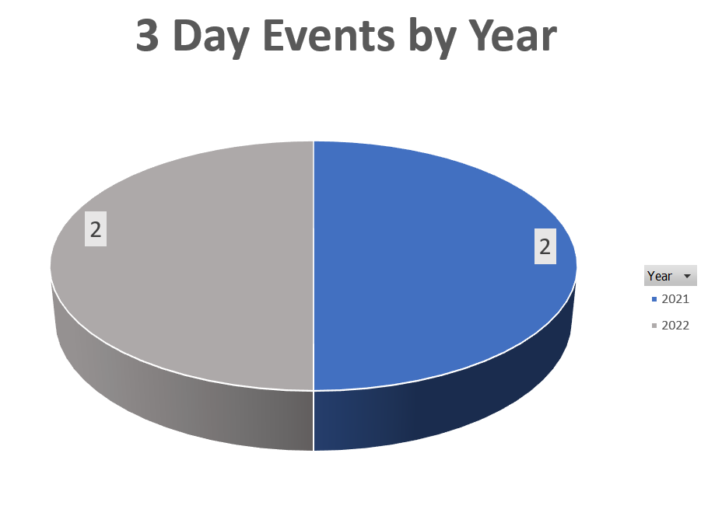
Number of Tournament Types by Year
A look at how many of each tournament was held
each year and how that might impact maintenance

Slide 10
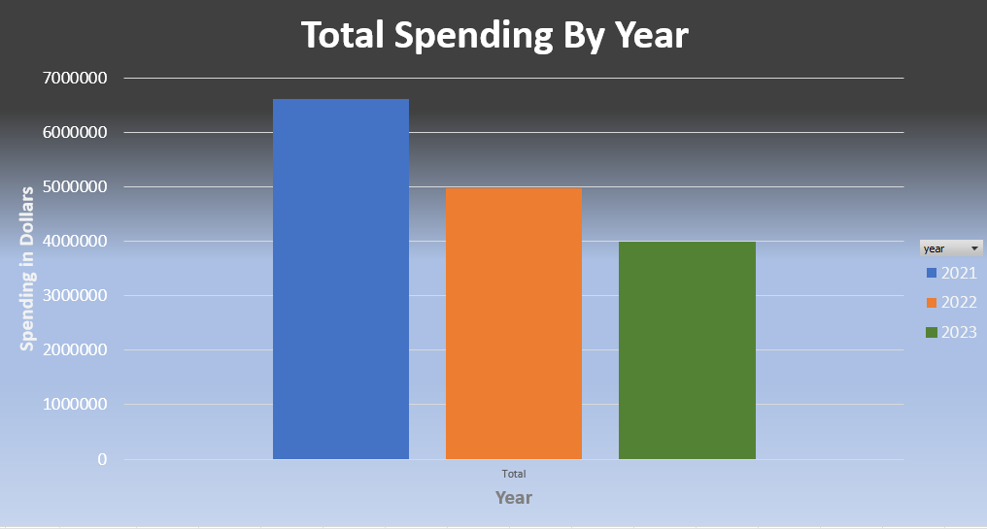
Total Spending by Year
Total Visitor Spending in the region displayed by yearly total

Slide 11
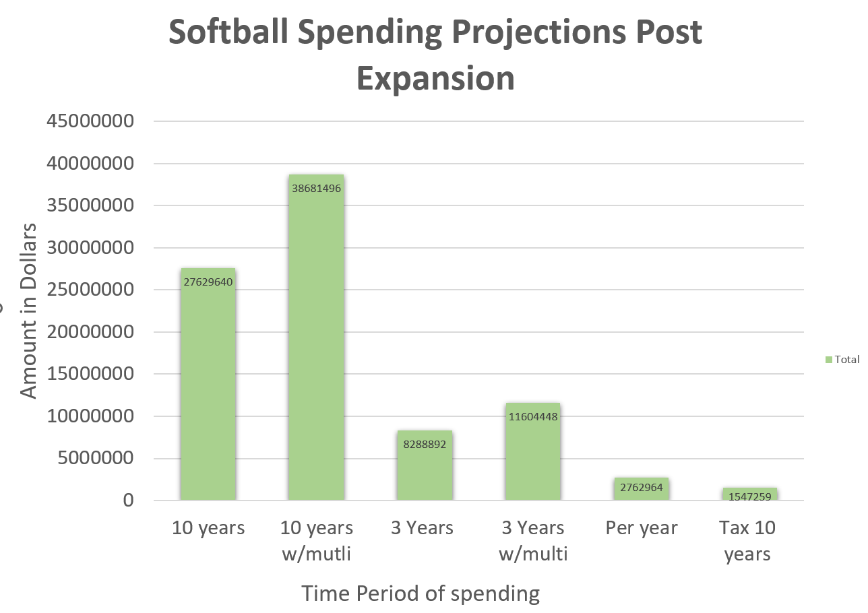
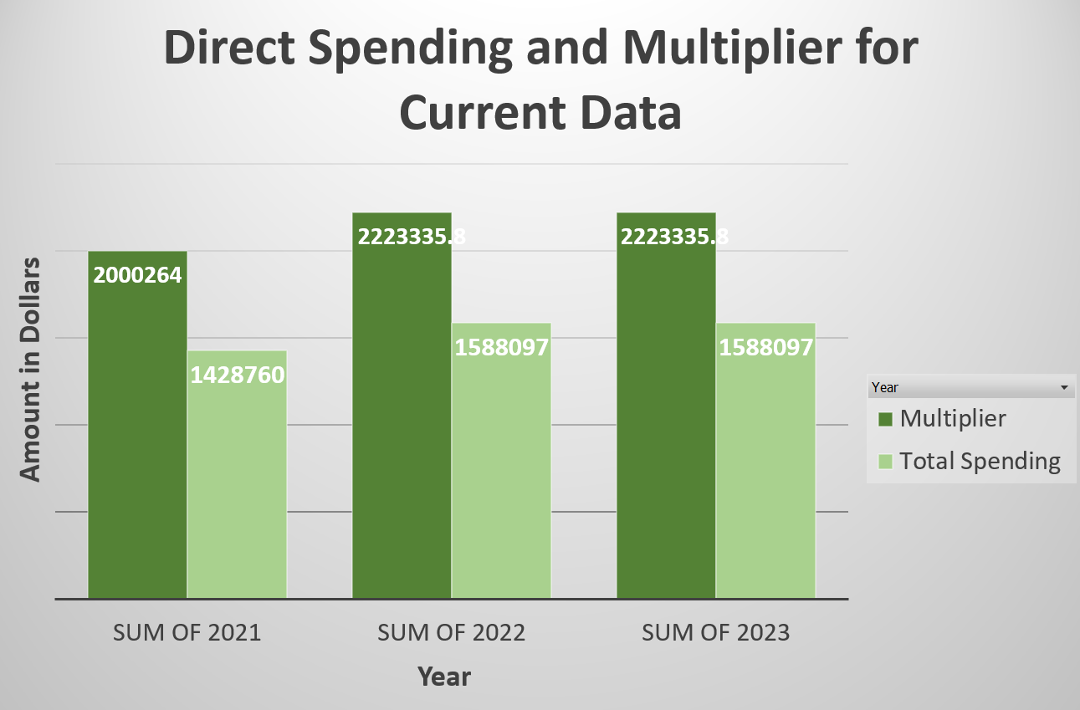
Spending by Sport: Softball

Slide 12
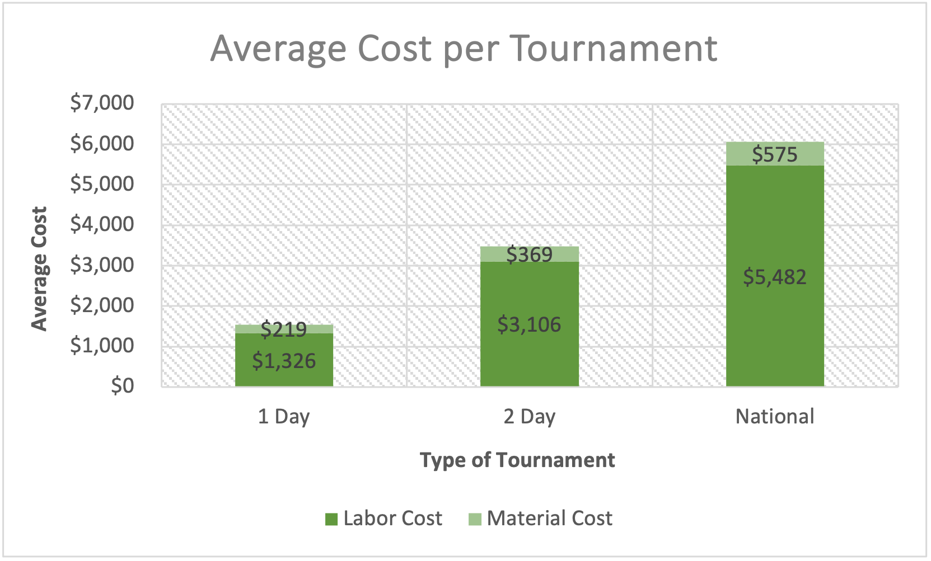
Average Maintenance Cost per Type of Tournament
Total Cost for 1-Day Tournament: $1,545
Total Cost for 2-Day Tournament: $3,475
Total Cost for National Tournament: $6,057

Slide 13
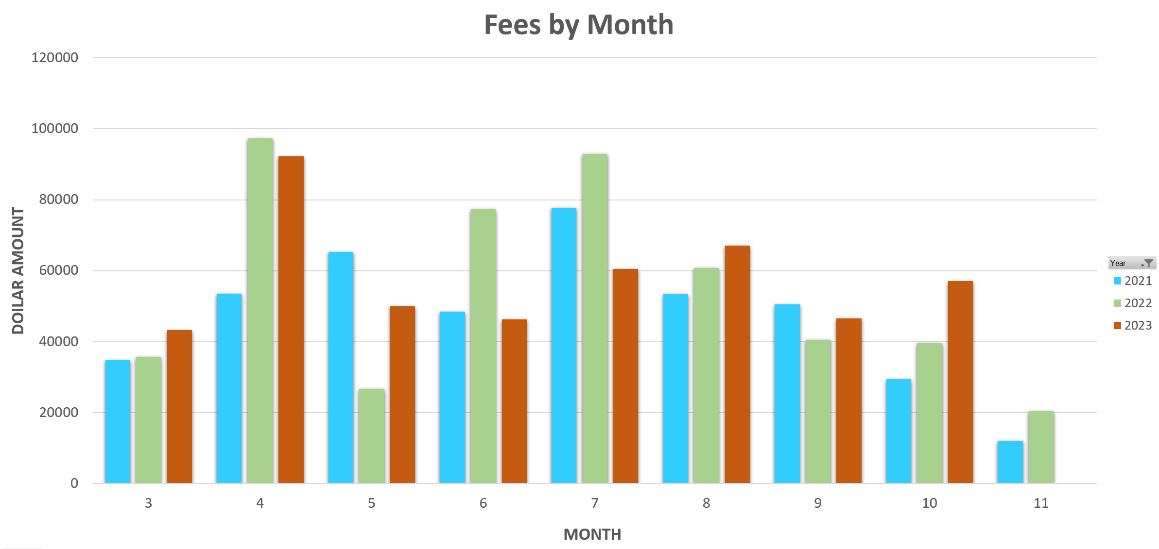
Fees Charged to Teams Totals by Month
Fee Totals per Month found using Fee data provided by JC Parks and Rec.

Slide 14
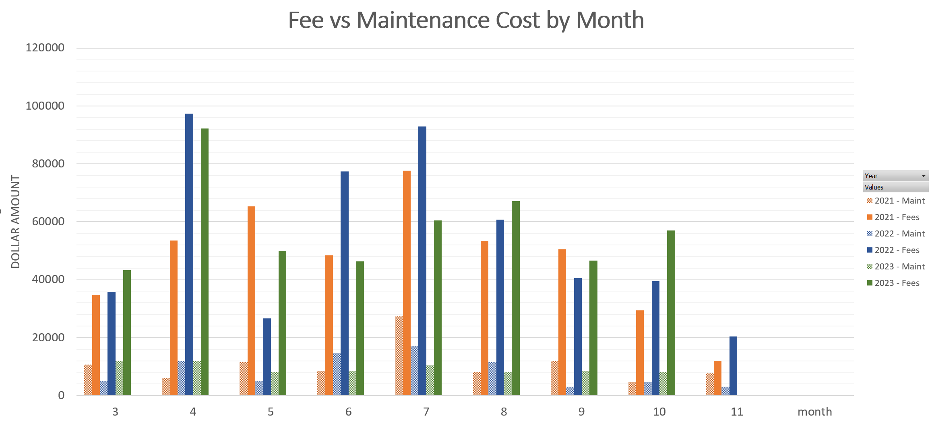
Comparison of Fees Charged vs Maintenance
Fee vs Maintenance charged for facility use, found using maintenance scans from
JC Parks and Rec Dept.

Slide 15
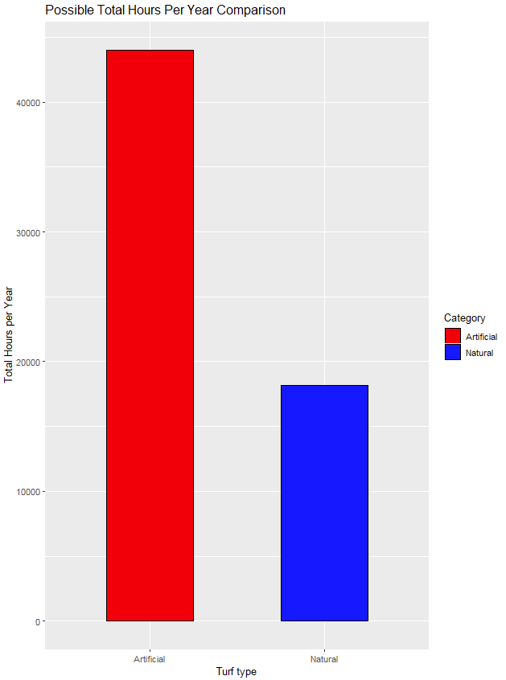
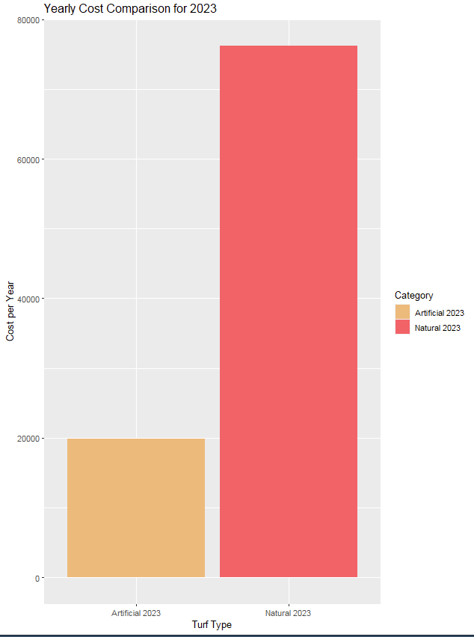
Field Type Comparison
Using supplied data summed expenses for year to find total cost of field maintenance.
This is compared to the total hours of use each field can support per year

Slide 16
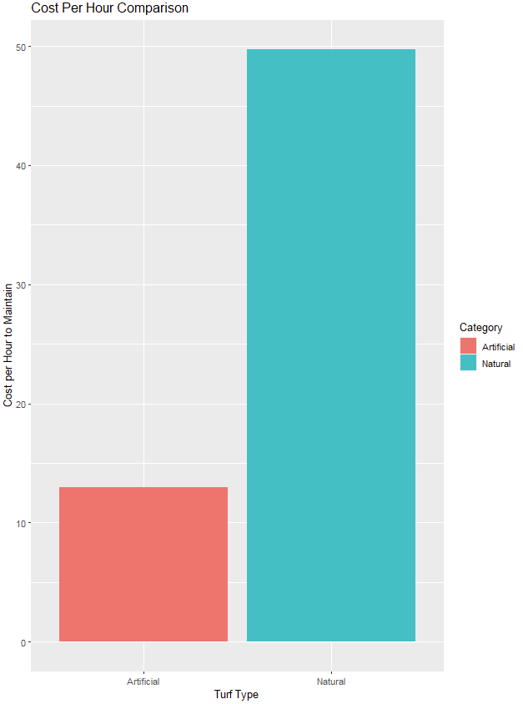
Turf Cost Comparison
Preliminary estimate made based off of existing information showing the hourly cost of labor for each field type.

Slide 17

USA Softball 18U National Championship July 2023
The USA Softball National Tournament is one of the largest tournaments hosted by Visit JC each year.
In 2023, this 5-day event was held at Winged Deer Park for the 18U Girls Class 'A' Fastpitch softball.
Total Attendees | 1,320
Average Spent per Day | $132
Average Hotel Rate per Night | $118
Total Visitor Spending | $871,200
Sales Tax Revenue | $10,995
Lodging Tax Revenue | $9,499

Slide 18
Collecting Additional Information

Slide 19

The Survey
To capture additional information, we have created and distributed a survey
We hope to capture such visitor behavior as:
How far someone needs to travel before they are willing to stay overnight
How much someone typically spends on a day/overnight trip
What difference if any exist between in spending between age groups
What difference if any exist in spending between sports

Slide 20
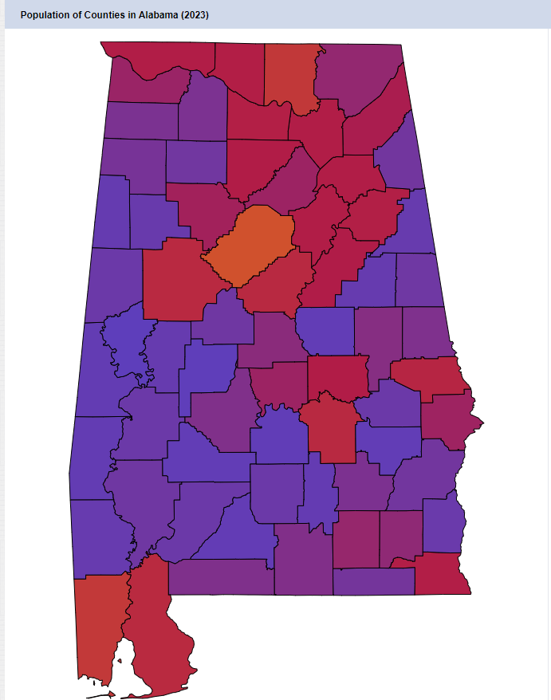
The Survey Distribution
To distribute the survey most effectively we are working with the 10 most populous counties in each state within the Southeastern region of the US.
Within each of the 10, we are contacting baseball/softball/soccer organizations to have the survey distributed to their members.

Slide 21
The Multiplier Effect and Estimates
A brief look at the first stage of our analysis

Slide 22
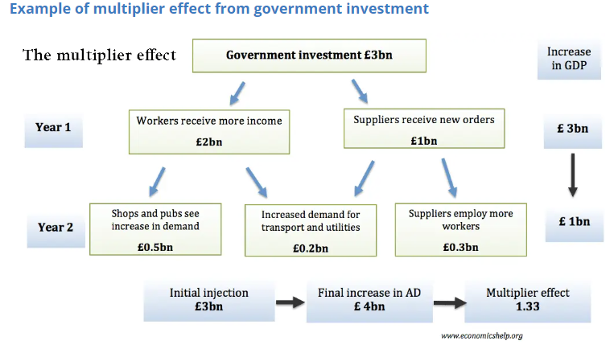
Multiplier Effect
How the multiplier effect works with a 3-billion-pound initial investment

Slide 23
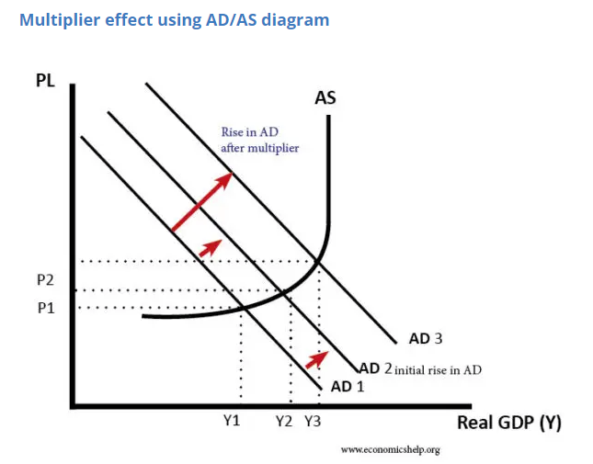
Multiplier Effect Pt2
Multiplier Effect on Aggregate Demand, Reflecting outside spending in an economy

Slide 24
How The Estimates Are Created
JC population 71,278
Population Density in Thousands=0.407
Chang’s Multiplier: 1.566+0.6*ln(Pop)-0.009(PopDen)
Using our values this yielded: 1.4583
We also add a capture rate of 60-70% to account for leakages in the local economy
This allows for an initial impact assessment
Utilizing a secondary study, we find a Multiplier for use with our data that doesn’t use the input/output model typically used.

Slide 25
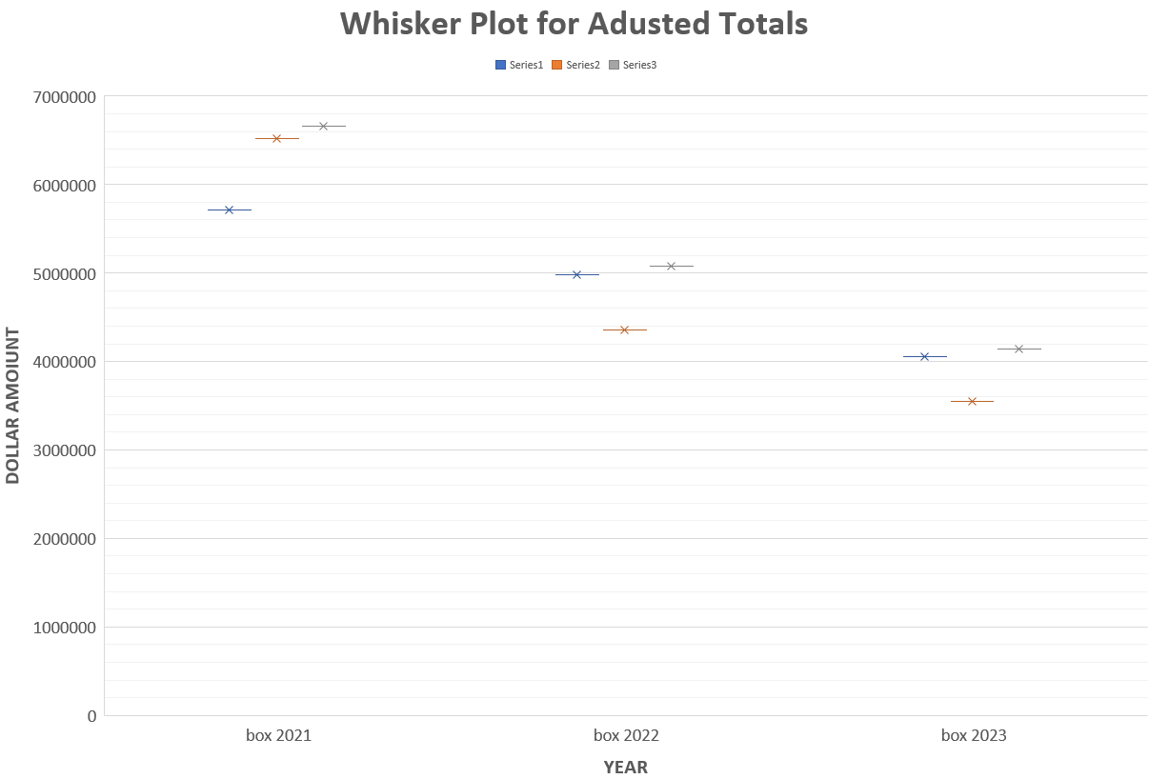
Adjusted Spending Totals
Whisker Plot displays new range calculated for Revenue using Multiplier

Slide 26
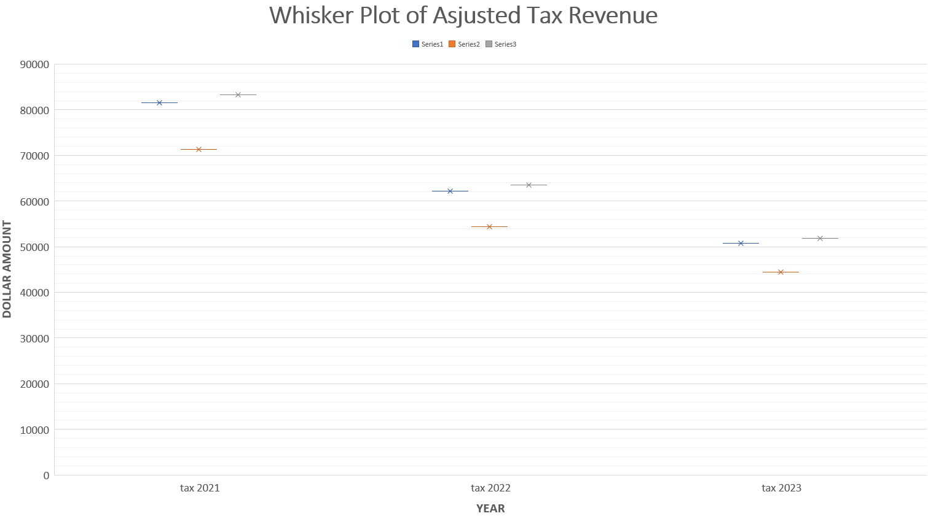
Adjusted Tax Revenues
Whisker Plot of adjusted tax revenue, found using spending total per year
Multiplied by tax rate of 1.25% for local revenues

Slide 27
A Brief Look At Input Output Models
A brief overview of why input/output models are important for the analysis

Slide 28
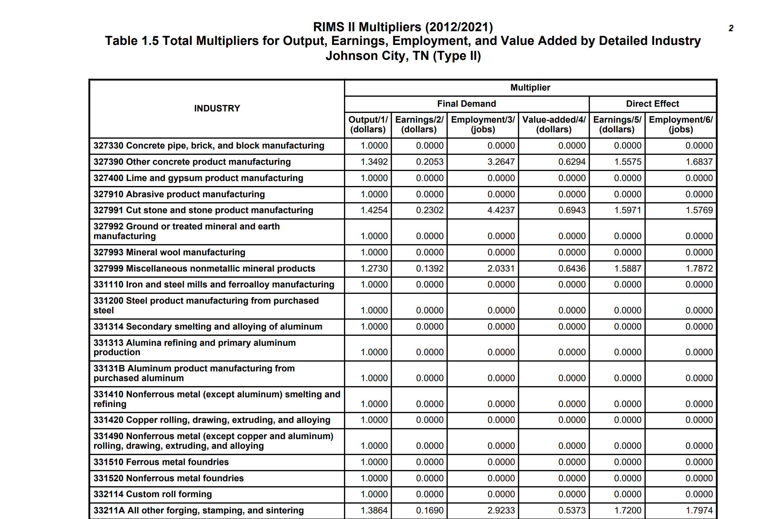
RIMS II Table Example w/Final Demand Multipliers
RIMS II Multiplier for the Johnson City area. This example shows how the multiplier
table takes in to account the specific production of a region.

Slide 29
Assumptions made when Using I/O model
RIMS II is a backward-linkage model
RIMS II uses Fixed Purchase Patterns
Industry Homogeneity
No Supply Constraints
No Regional Feedback
No Time Dimension

Slide 30
Additional RIMS II information
RIMS II multipliers are only meaningful for analyzing the impact of final demand change in a region. Final demand consist of a number of different types of transactions:
Purchases by consumers outside the region
Investment in new buildings, equipment, and software
Purchases by government
Purchases by households

Slide 31
Moving Forward
Survey Date
Collection
Build Cohesive
Dataset
Apply Multipliers
To Estimates
Obtain adjusted
Estimates
Compile Economic
Analysis
Compile Financial
Analysis

